Slide 1

Corona Virus Analysis With SQL

Slide 2
OVERVIEW
INTRODUCTION
DATASET OVERVIEW
SCOPE
IMPORTING CSV FILE
PREPARING DATA
EXAMINING/EXPLORING DATA
ANALYZING DATA AS PER MONTH
ANALYZING DATA AS PER YEAR
ANALYZING DATA STATISTICALLY
ANALYZING DATA GEOGRAPHICALLY

Slide 3
INTRODUCTION
Introduction to Corona Virus
Coronavirus disease 2019 (COVID-19) is a highly contagious viral illness caused by severe acute respiratory syndrome SARS-CoV-2. It has had a devastating effect on the world’s demographics resulting in more than 5.3 million deaths worldwide. It has emerged as the most consequential global health crisis since the era of the influenza pandemic of 1918.The persistence of disabling symptoms long after the acute illness has resolved has become known as covid-19.After the first cases of this predominantly respiratory viral illness were first reported in Wuhan, Hubei Province, China, in late December 2019, SARS-CoV-2 rapidly disseminated across the world in a short span of time, compelling the World Health Organization (WHO) to declare it as a global pandemic on March 11, 2020.The outbreak of COVID-19 has proven to be a world- wide unprecedented disaster.

Slide 4
Dataset Overview
It contains the description of data which will be used for further analysis. It contains information about corona virus pandemic.
Description about individual column:
Province: Geographic subdivision within a country/region.
Country/Region: Geographic entity where data is recorded.
Latitude: North-south position on Earth's surface.
Longitude: East-west position on Earth's surface.
Date: Recorded date of CORONA VIRUS data.
Confirmed: Number of diagnosed CORONA VIRUS cases.
Deaths: Number of CORONA VIRUS related deaths.
Recovered: Number of recovered CORONA VIRUS cases.

Slide 5
SCOPE
The scope of this task is to analyse corona virus dataset and to find useful insight using SQL. To get familiar with real world based project.
Also to check our SQL knowledge by answering specific SQL queries which will help us to understand data in a better way.

Slide 6
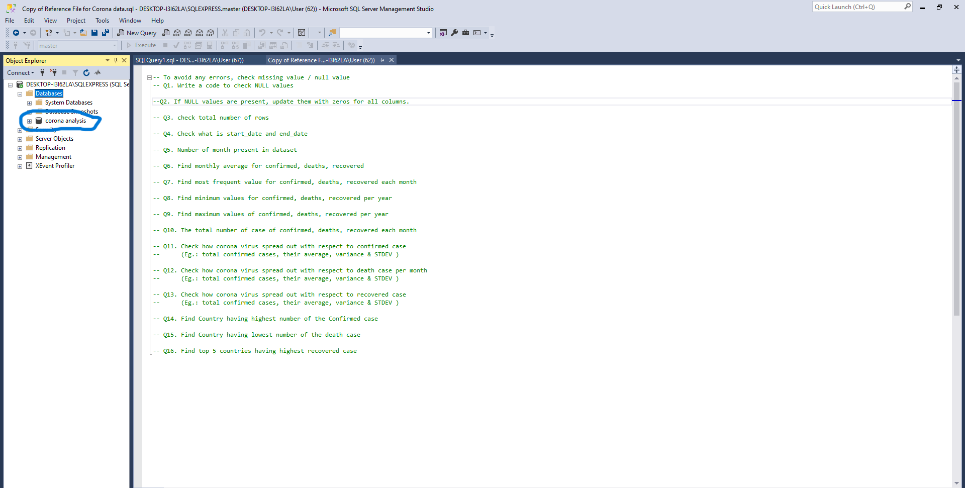
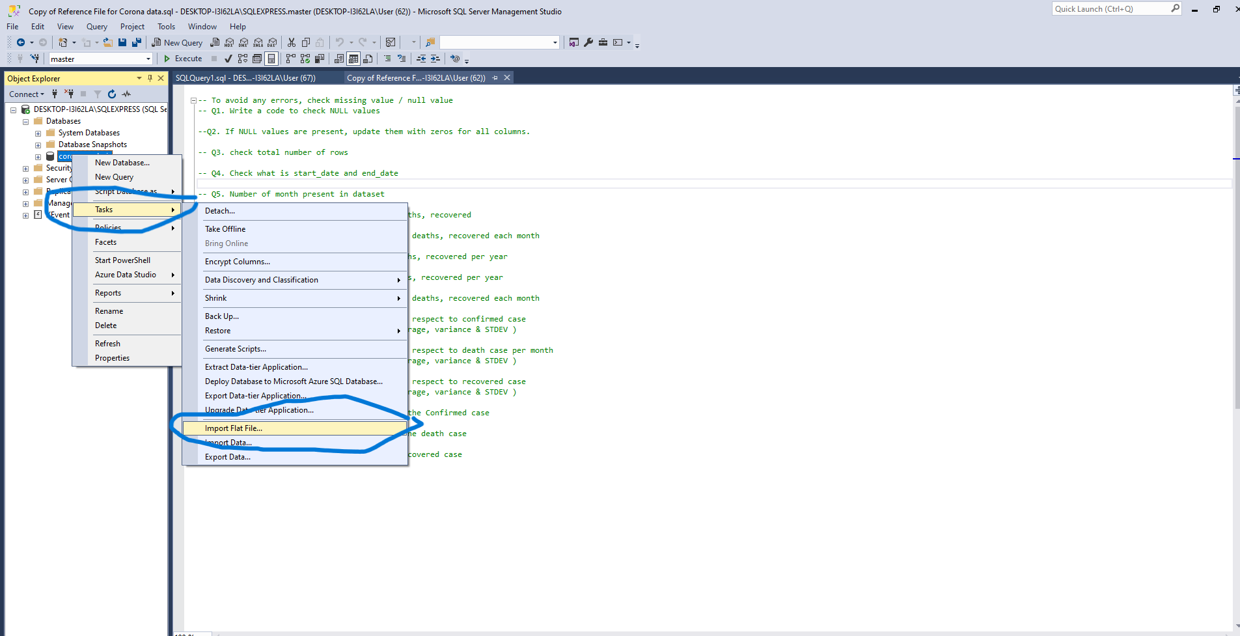
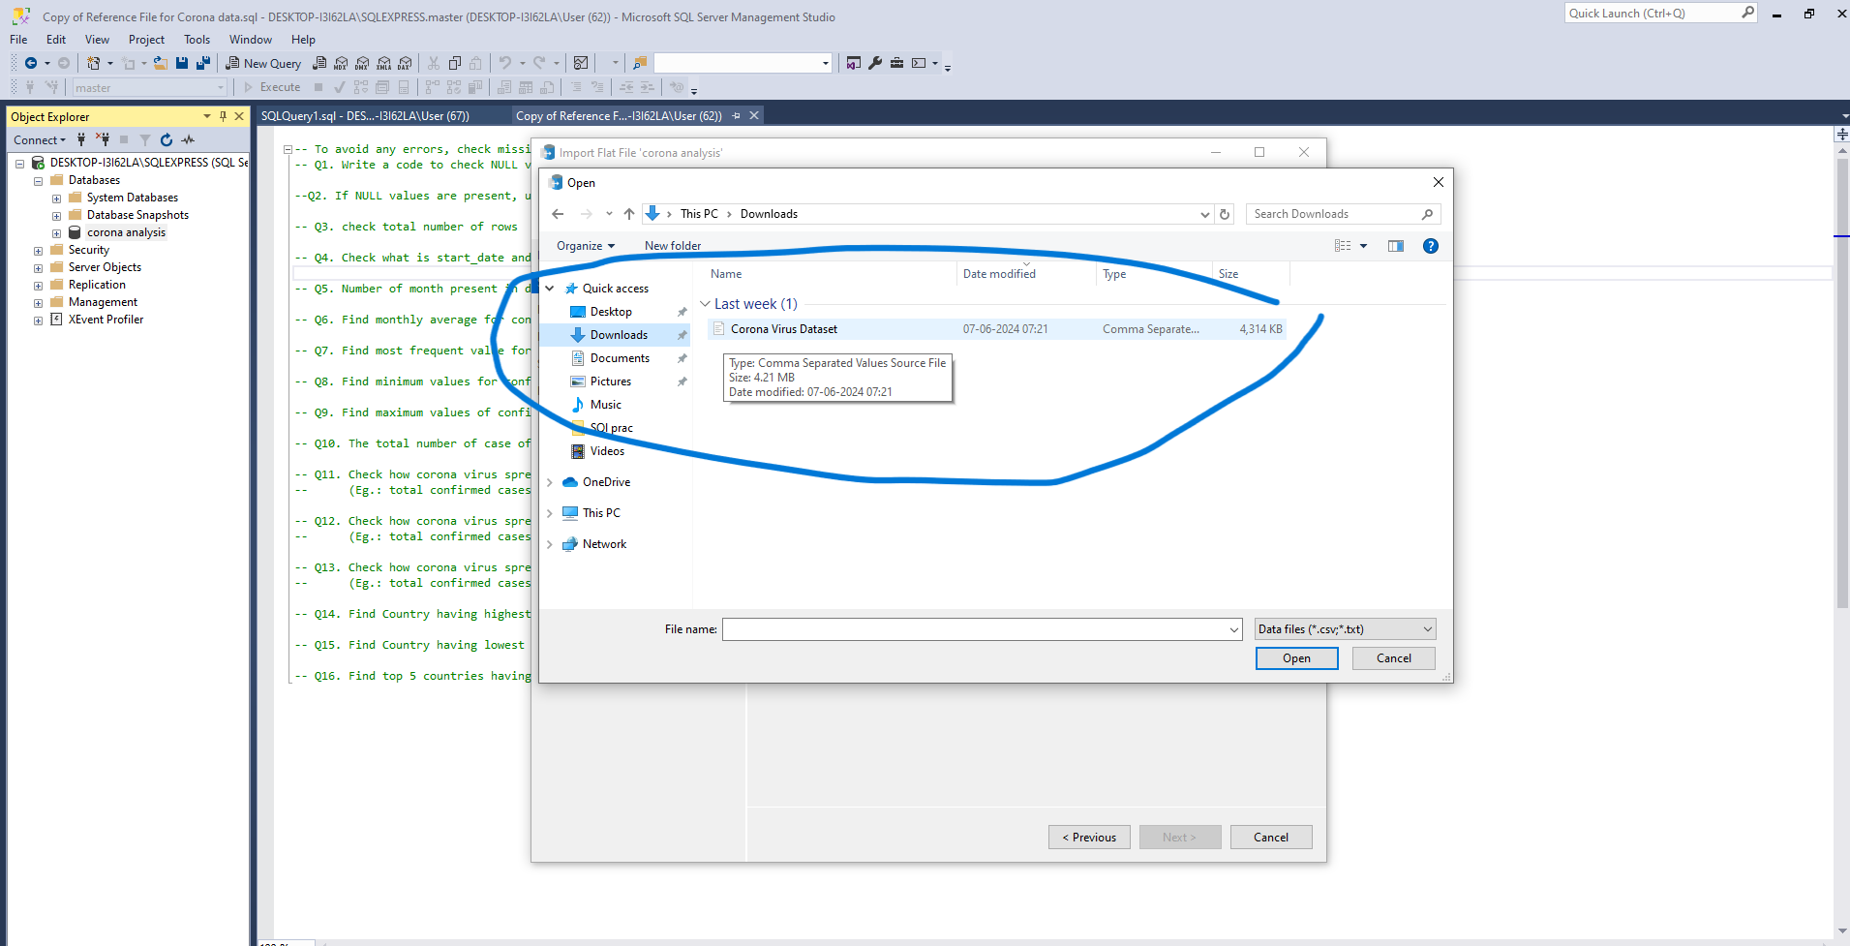
Importing CSV File Into SQL
Steps to import csv/flat file
Create a Database
Select that database
Click right >> Task>> Import flat file
Select any file of your choice
Click ok

Slide 7
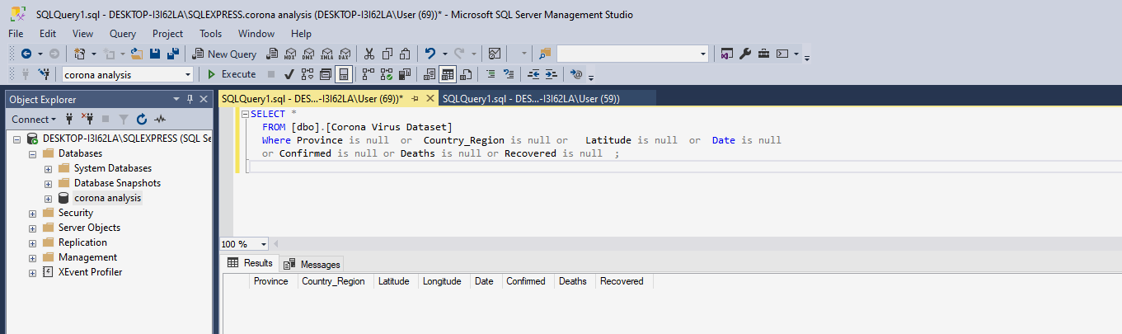
Preparing Data
The first query was to find null values from the given data
A null value in a relational database is used when the value in a column is unknown or missing
There are multiple Methods and function in SQL to find null values such as :
IFNULL(), ISNULL(), COALESCE(), and NVL() .

Slide 8
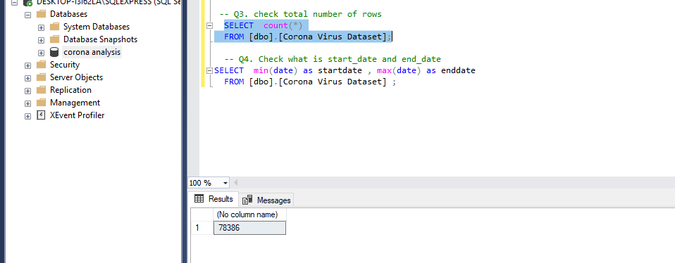
Examining data
In this query we have to explore/examine data to find out the total rows
Present in the data set.

Slide 9
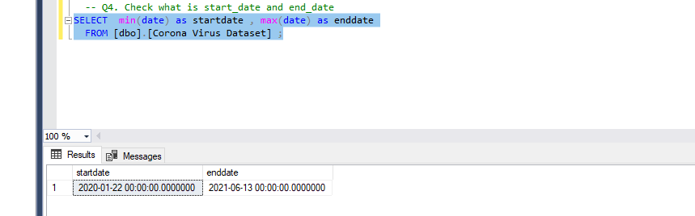
Examining data
In this query we have to explore/examine data to find "Start Date and End Date" from the date column

Slide 10
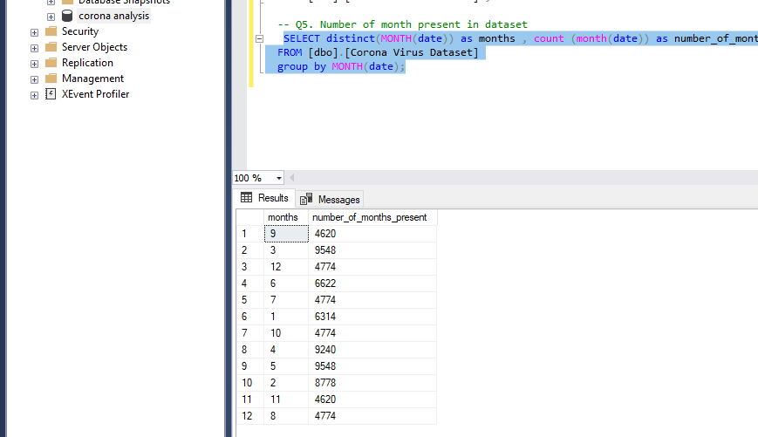
Examining data
In this query we have to explore/examine data to find total number of month present
In the dataset

Slide 11
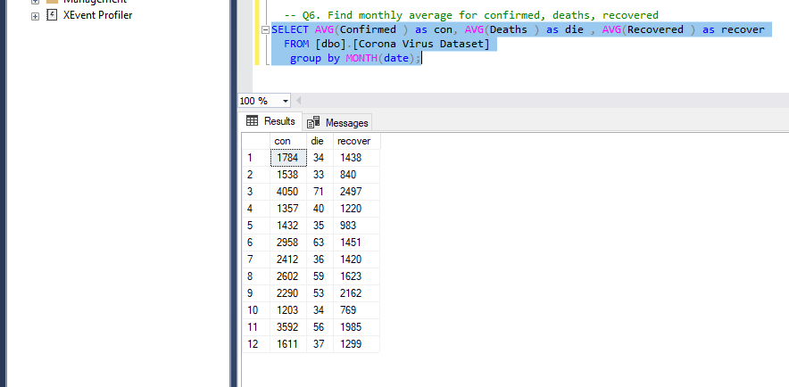
Analysing data as per month
In this query we have to analyse the data to find monthly average for confirmed, deaths, recovered
Using aggregate functions.

Slide 12
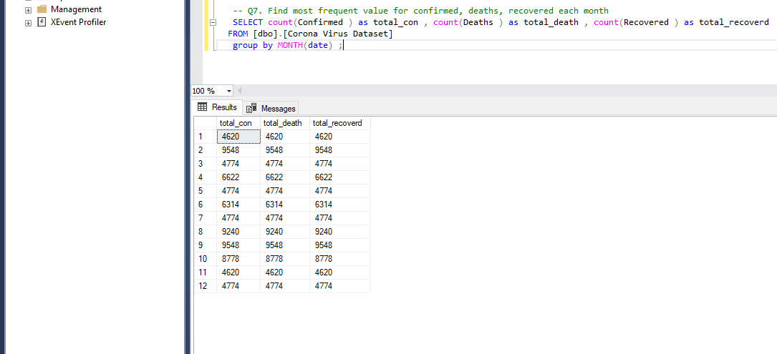
Analysing data as per month
In this query we have to analyse the data to find most frequent value for confirmed, deaths, recovered per month using aggregate functions.

Slide 13
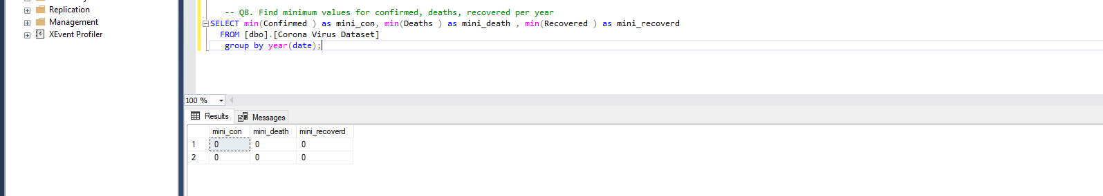
Analysing data as per year
In this query we have to analyse the data to find minimum values for confirmed, deaths, recovered per year using aggregate functions.

Slide 14
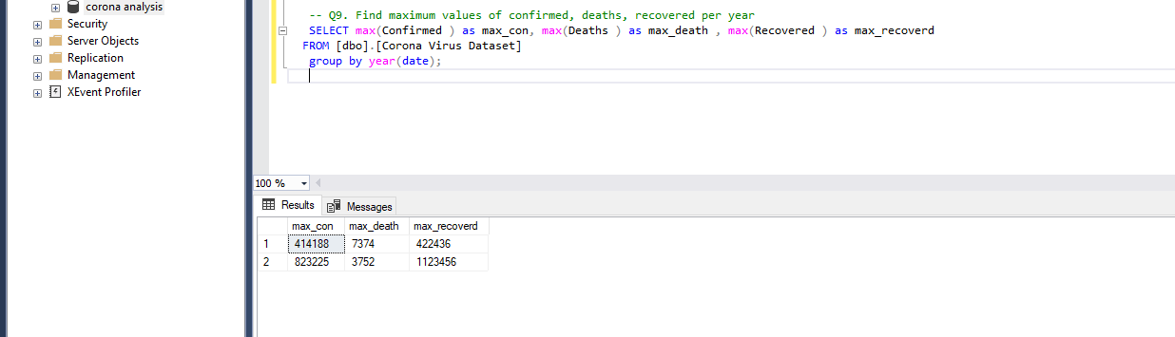
Analysing data as per year
In this query we have to analyse the data to find maximum values for confirmed, deaths, recovered per year using aggregate functions.

Slide 15
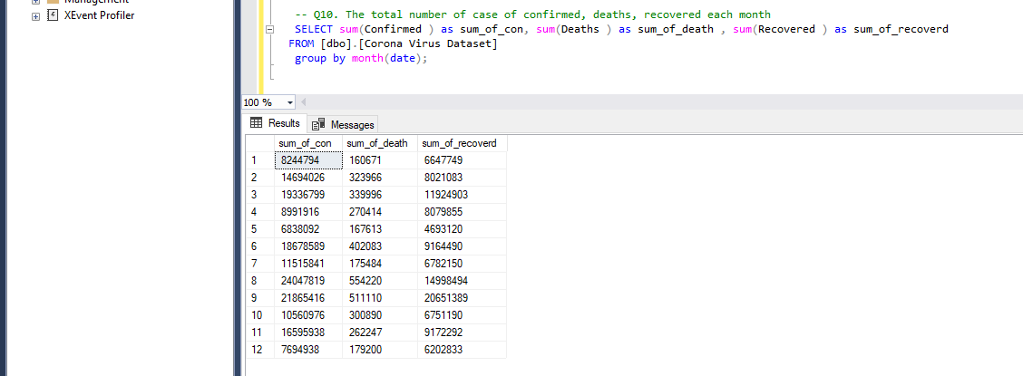
Analysing data statistically
In this query we have to analyse the data to find the total number or sum of case of confirmed, deaths, recovered each month using aggregate functions.

Slide 16
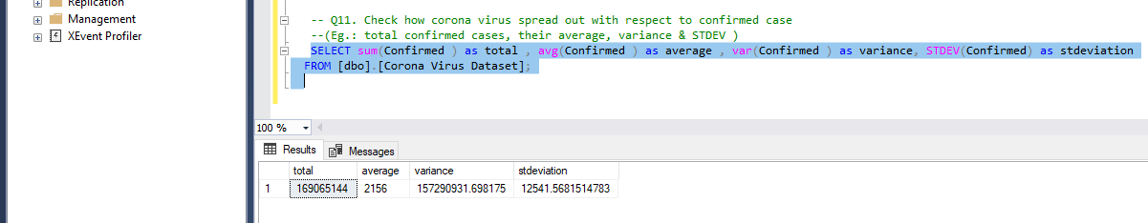
Analysing data statistically
In this query we have to analyse the data to Check how corona virus spread out with respect to confirmed case such as total confirmed cases, their average, variance & STDEV

Slide 17
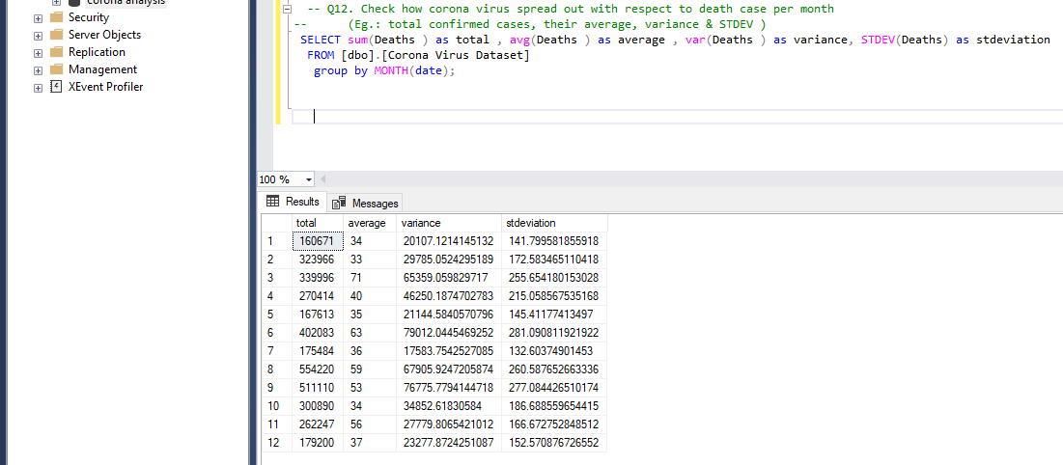
Analysing data statistically
In this query we have to analyse the data to Check how corona virus spread out with respect to Death case such as total death cases, their average, variance & STDEV for each month.

Slide 18
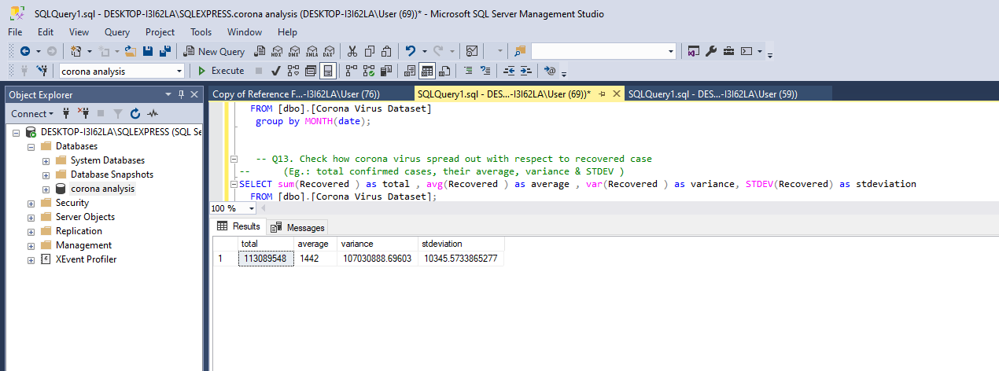
Analysing data statistically
In this query we have to analyse the data to Check how corona virus spread out with respect to recovered case such as total death cases, their average, variance & STDEV ..

Slide 19
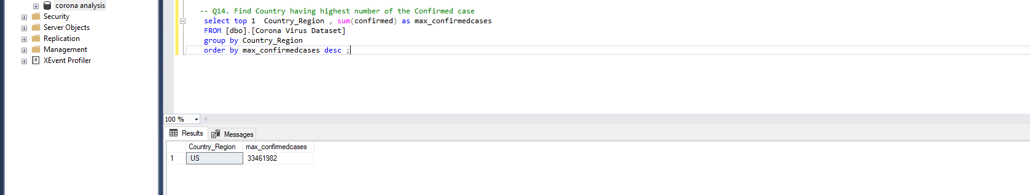
Analysing data geographically
In this query we have to analyse the data Find Country having highest number of the Confirmed cases .

Slide 20
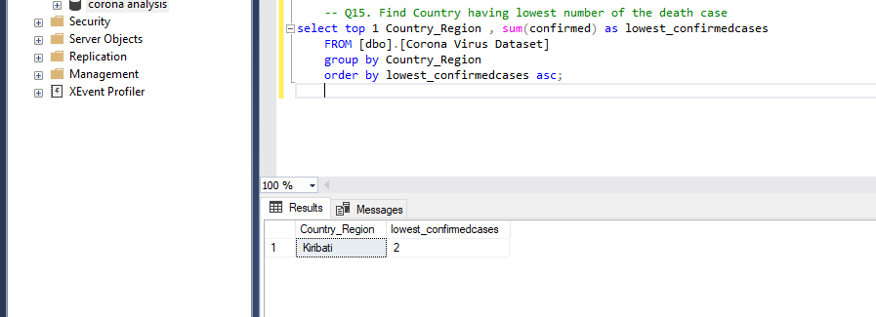
Analysing data geographically
In this query we have to analyse the data Find Country having lowest number of the Death cases .

Slide 21
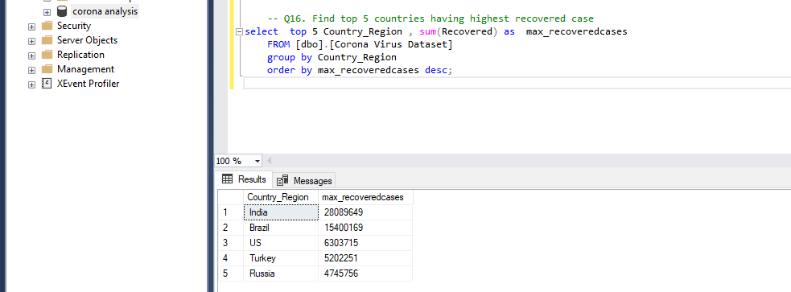
Analysing data geographically
In this query we have to analyse the data to find top 5 Countries having highest number of the Recovered cases .

Slide 22
Conclusion
After precisely analysing the dataset we came to know that the Start Date of corona virus pandemic was
22nd Jan 2020 and the End Date was 13th June 2021.
The Lowest values for confirmed, Death, Recovered was "0" and the Highest values for confirmed, Death, Recovered was 414188, 7374, 422436 respectively.
The highest number of Confirmed cases were found in US which was 33461982
The lowest number of Death cases were found in KRIBATI which was 2
The top 5 countries having the highest Recovered cases were India, Brazil, US, Turkey, Russia and their values were 28089649, 15400169, 6303715, 5202251, 4745756 respectively.
The average of Confirmed , Death , Recovered cases were 2156, 46,1142.
THANK YOU!!!

